Slide 1
HR Analytics
By :- Anmol Malviya

Slide 2
About project
Every company has a HR Department which deals with various recruitment , Placement and Promotions related work of the company. Here in this project we have a huge dataset in from which we are going to extract insights which can be useful for hr department and higher authorities to work on and to gain knowledge about the employees and get help to give promotions. We have extracted many different insights which we will observe further.

Slide 3
About dataset
The dataset is about the employee details data of a company. data consist of various information related to employee of hr, sales and research & development department. The dashboard made is for the HR team and higher management.
It contain information like age, gender, job role, marital status, monthly income, promotion detail and many other related details.

Slide 4
Insights to find out ?
Ratio of male/female employees
How many employees are due for promotion department wise
What are the marital status ratio of employees
No. of Employees according to their service years
How many employees are active worker
Residential status of employees from the office based on distance
Satisfaction level of employees

Slide 5
Dashboard

Slide 6
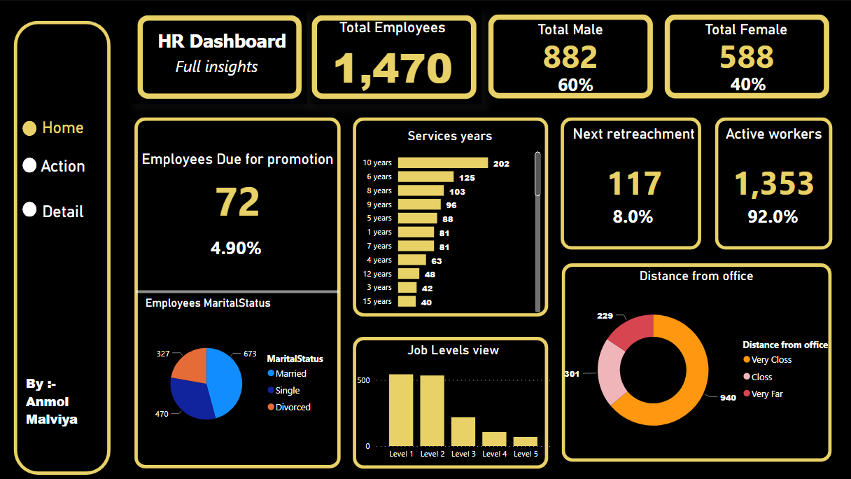

Slide 7
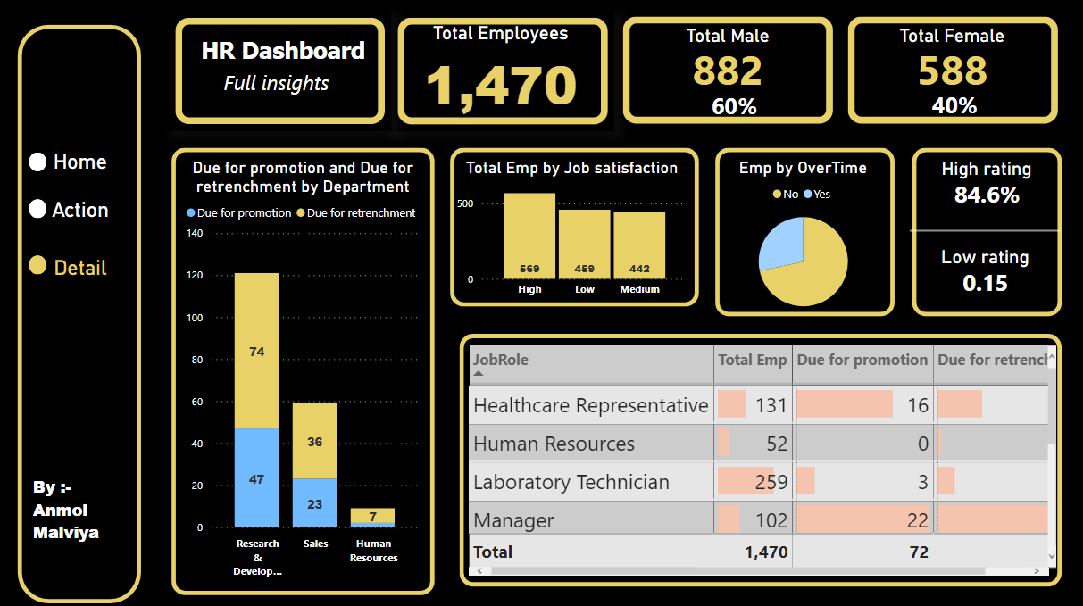

Slide 8
